Slide 1

“Face detection/Recognition with
Hardware Actuation”
GROUP NO:
Roll No. | Name of Students
062 | Sujoy Dev
176 | Anmol Majithia
031 | Sanjana Bhute
1

Slide 2

INTRODUCTION
A facial recognition system is a technology capable of identifying or verifying a person from a digital image or a video frame from a video source. There are multiples methods in which facial recognition systems work, but in general, they work by comparing selected facial features from given image with faces within a database.
While initially a form of computer application, it has seen wider uses in recent times on mobile platforms and in other forms of technology, such as robotics.
It is typically used in security systems and can be compared to other biometrics such as fingerprint or eye iris recognition systems.Recently, it has also become popular as a commercial identification and marketing tool.
OpenCV (Open Source Computer Vision) is a library of programming functions mainly aimed at real-time computer vision

Slide 3
ALGORITHM
START
Create csv file(using a python script)
Display menu
Input choice
If choice==1
open camera window for detection
display name if the face is recognized
If choice==2
open camera window for detection
input face data by pressing spacebar
If choice==3
read csv file
train recognizer with saved images
If choice==4
display about
If choice==5
display how to
If choice==6
exit
6. STOP
3

Slide 4
FLOWCHART
START
Disp menu
Face rec
Load models
Create csv
If choice==1
Face data input
If choice==2
If choice
If choice==3
Train Recognizer
If choice==4
If choice==5
Disp about
If choice==6
Disp how to
STOP
4

Slide 5
MODULES
LIST OF MODULES :-
Mat detectAndDisplay(Mat, vector<string>&);
Mat detectAndsave(Mat, string);
bool dirExists(string);
static void csv(const string& , vector<Mat>& , vector<int>&);
serialPort.cpp
void display(); //about
void display2(); // how to
void display3(); // error message
void display4(); // error message
5

Slide 6
EXPLANATION OF EACH MODULE
int main()
Displays choices to the user:
On pressing 1 : Detects or Recognizes faces
On pressing 2 : Allows to save face data with a name
On pressing 3 : Trains the recognizer to detect newly fed faces
On pressing 4 : Gives an information about OpenCV, Face Recognition and Face Detection
On pressing 5 : Teaches “How To” work with this program
On pressing 6 : Clears everything and closes all windows to exit
6

Slide 7
EXPLANATION OF EACH MODULE
Mat detectAndDisplay(Mat, vector<string>&);
Detects faces and highlights them
If the face detected is present in database, displays name along with the face
Mat detectAndsave(Mat, string);
Detects face
If face is detected prompts option to save it
Returns the saved image
bool dirExists(string);
Checks existence of the image directory and the person directories and creates a dataset if it doesn’t already exist
7

Slide 8
EXPLANATION OF EACH MODULE
void display();
Displays information about OpenCV, Face Detection and Face Recognition
void display2();
Displays “How To” work with this program
void display3();
Called in case same username is entered twice and an error statement is to be displayed
void display4();
Called in case username is invalid and an error statement is to be displayed
static void csv(const string& , vector<Mat>& , vector<int>&);
Function used to read csv file
8

Slide 9
‘C++’ CONCEPTS USED
Vectors
File handling
Push_back
Functions
Looping
Conditional Branching
Etc.
9

Slide 10

SCREEN SHOTS
10

Slide 11
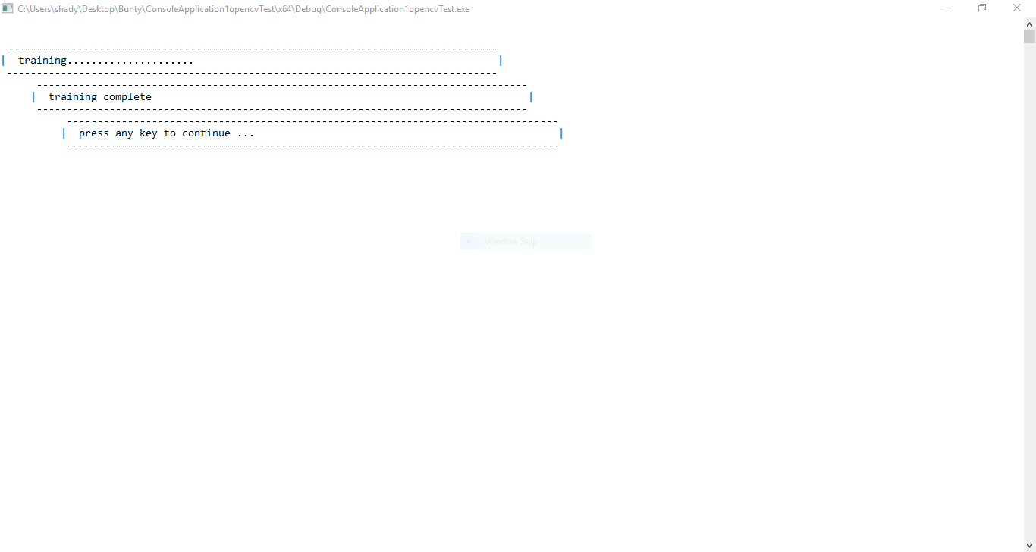
SCREEN SHOTS
11

Slide 12
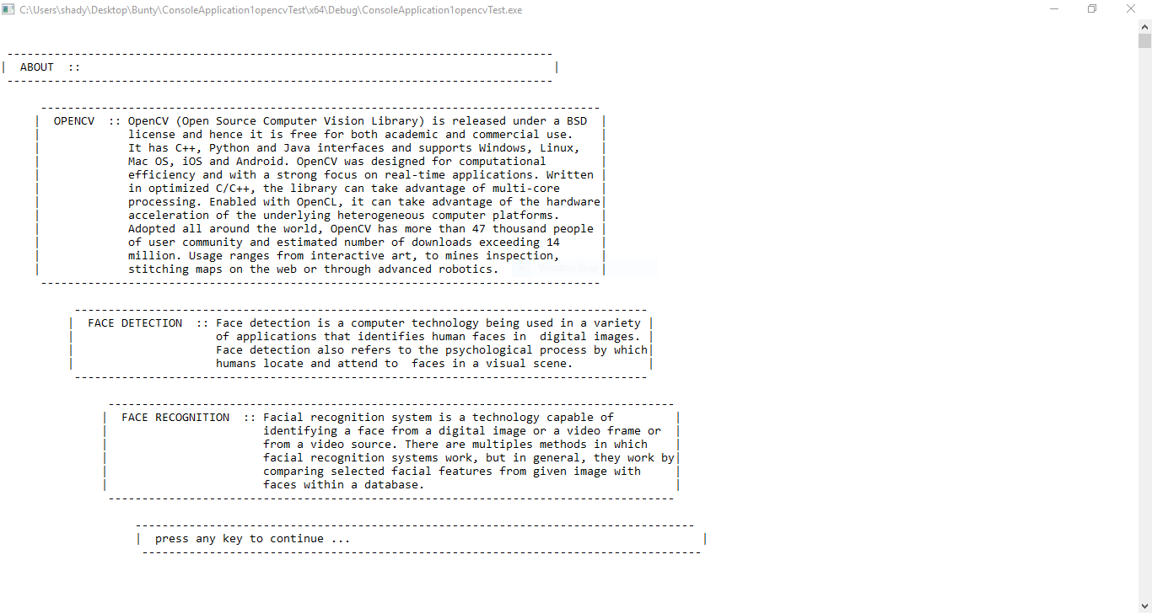
SCREEN SHOTS
12

Slide 13
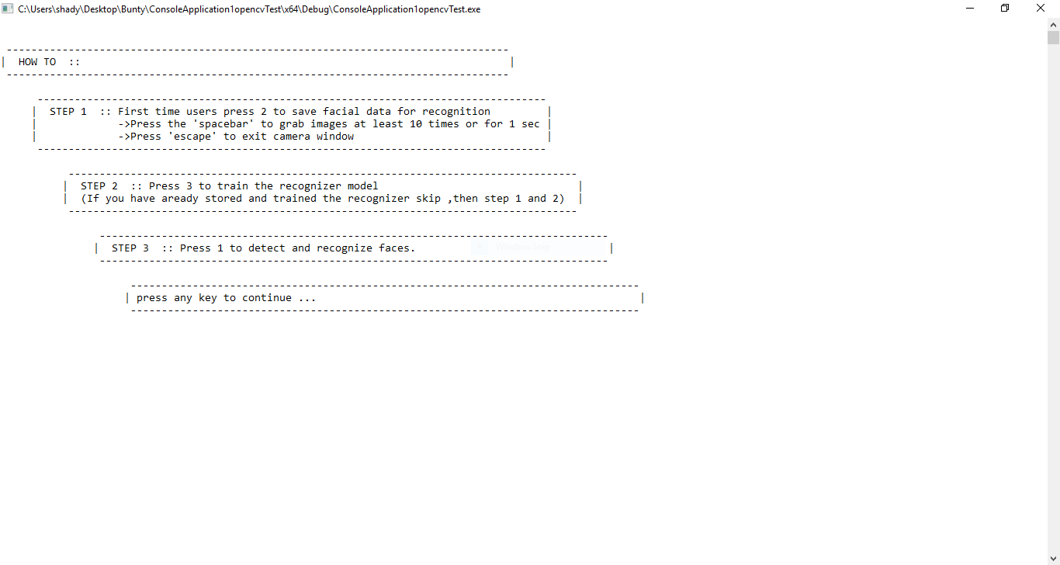
SCREEN SHOTS
13

Slide 14
CONCLUSION
Face recognition technologies have been associated generally with very costly top secure applications. Today the core technologies have evolved and the cost of equipment is going down dramatically due to the integration and the increasing processing power. Certain applications of face recognition technology are now cost effective, reliable and highly accurate. As a result there are no technological or financial barriers for stepping from the pilot project to widespread deployment.
Face recognition is both challenging as well as an important recognition technique. Among all the biometric techniques, face recognition approach possesses one great advantage, which is its user-friendliness (or non-intrusiveness).
14

Slide 15
REFERENCES
https://opencv.org/
https://github.com/opencv/opencv
https://towardsdatascience.com/face-recognition-how-lbph-works-90ec258c3d6b
https://www.superdatascience.com/opencv-face-recognition/
https://www.tutorialspoint.com/opencv/index.html
http://opencvexamples.blogspot.com/p/learning-opencv-functions-step-by-step.html
15

Slide 16

16

